Slide 1

Quarterback Salary and QB Career Performance in the National Football League
By: Andrew Fagundes

Slide 2
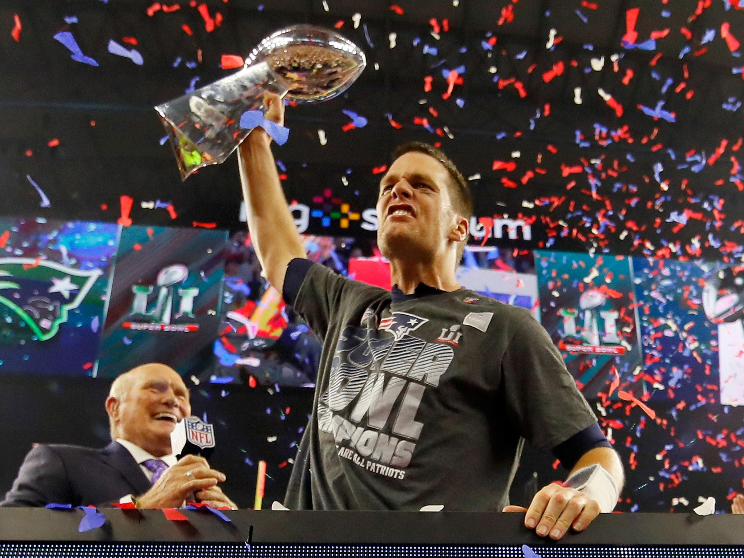
Intro: Why Was This Paper Written?
QB position is the most popular and active position in the NFL; some could say these players affect a team’s ability to win
Many QBs receive large salaries as further incentive to lead their teams to victory (Ex: Patrick Mahomes, Josh Allen make crazy money)
Is on-field productivity being compensated fairly?
Gameplay performance could depend on variables for seasonal performance and career longevity

Slide 3
Problem Statement and Hypothesis
Does an NFL quarterback’s career performance influence their compensation?
Metrics include passing yards, passing touchdowns, rushing yards, rushing touchdowns, pass attempts, interceptions, fumbles, pass completions, yards per game, and age
Normalized contract value of each QB serves as the target variable (normalized because the original salaries scale in the millions)
H_{o}: Career performance metrics do not significantly impact QB salaries.
H₁: Career performance metrics do significantly impact QB salaries.
This analysis helps teams and players make informed decisions about contracts, team composition, and player development; ensures contracts reflect performance trends

Slide 4
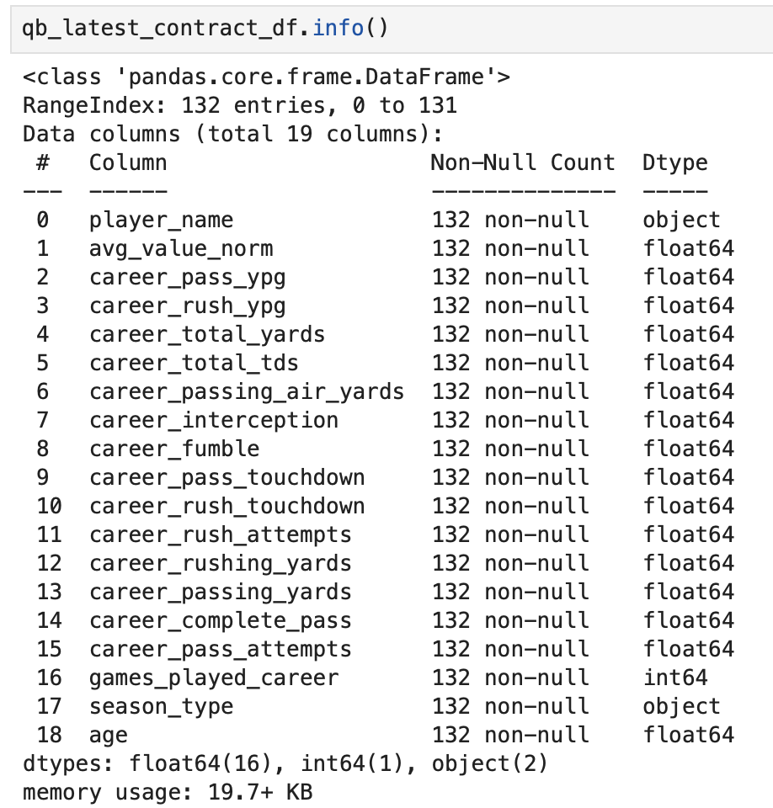
Summary of Data Analysis pt. 1
This project utilized two CSV datasets: one for NFL player data and the other for contract data, both collected from Kaggle repositories. The first dataset, yearly_player_stats_offense.csv, contains yearly performance metrics for all NFL offensive players from 2012 to 2024, including demographic data, draft status, and seasonal and career-long performance metrics (Hyde, 2025). The second dataset, combined_data_2000-2023.csv, includes contract data for all NFL players from 2000 to 2023, with the variable value_norm representing the total US dollar value of their contract at signing normalized to the NFL salary cap for a given year (Liu-Sontag, 2023).
QBs were filtered based on total regular season games played, most recent season played, average career contract value normalized per QB, and the most recent year of contract signing. Resulted in 132 unique QBs being tracked for this analysis
Career performance metrics, average contract value normalized, age, season type, and player name are final variables

Slide 5
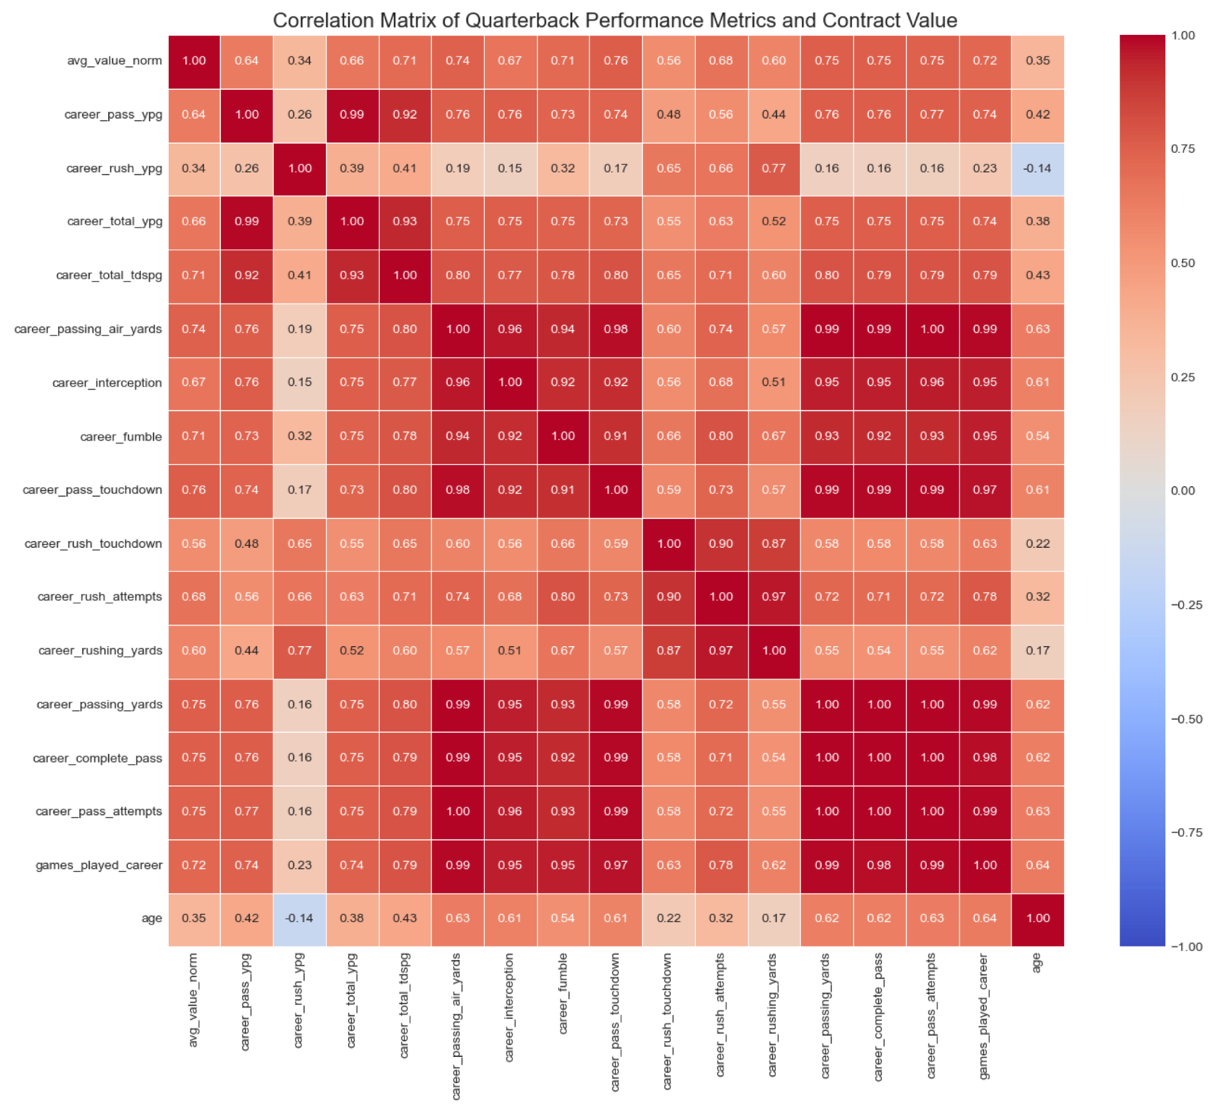
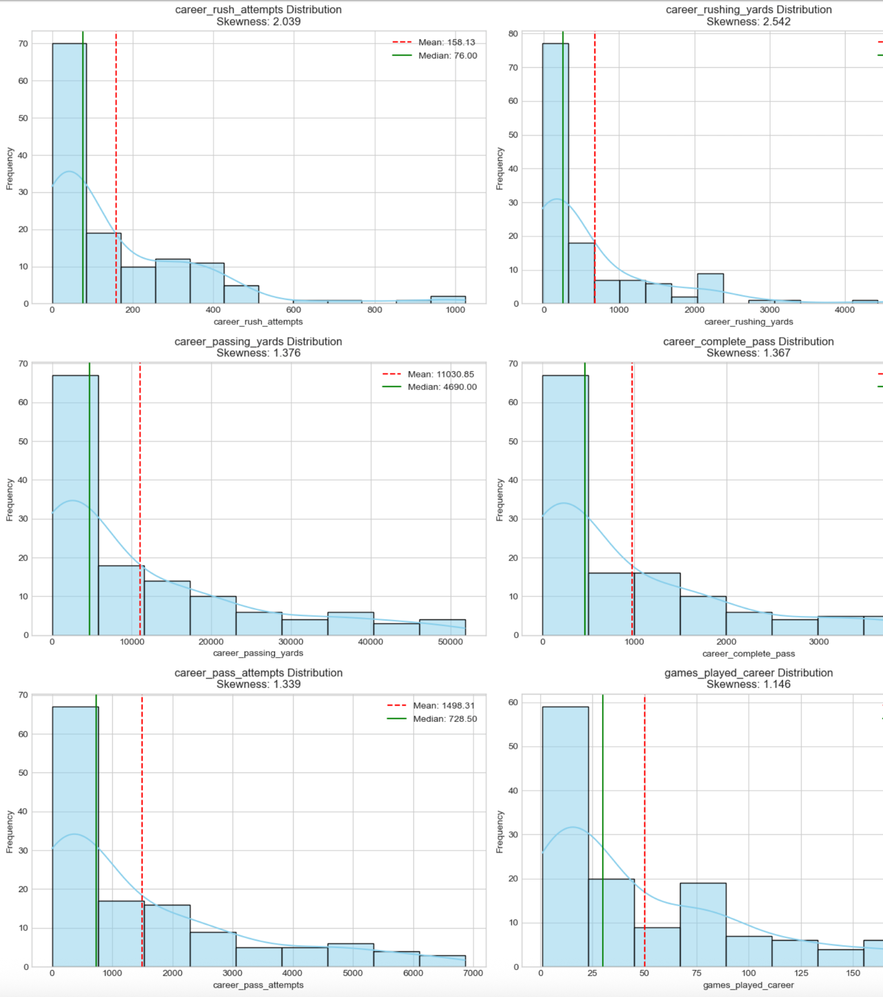
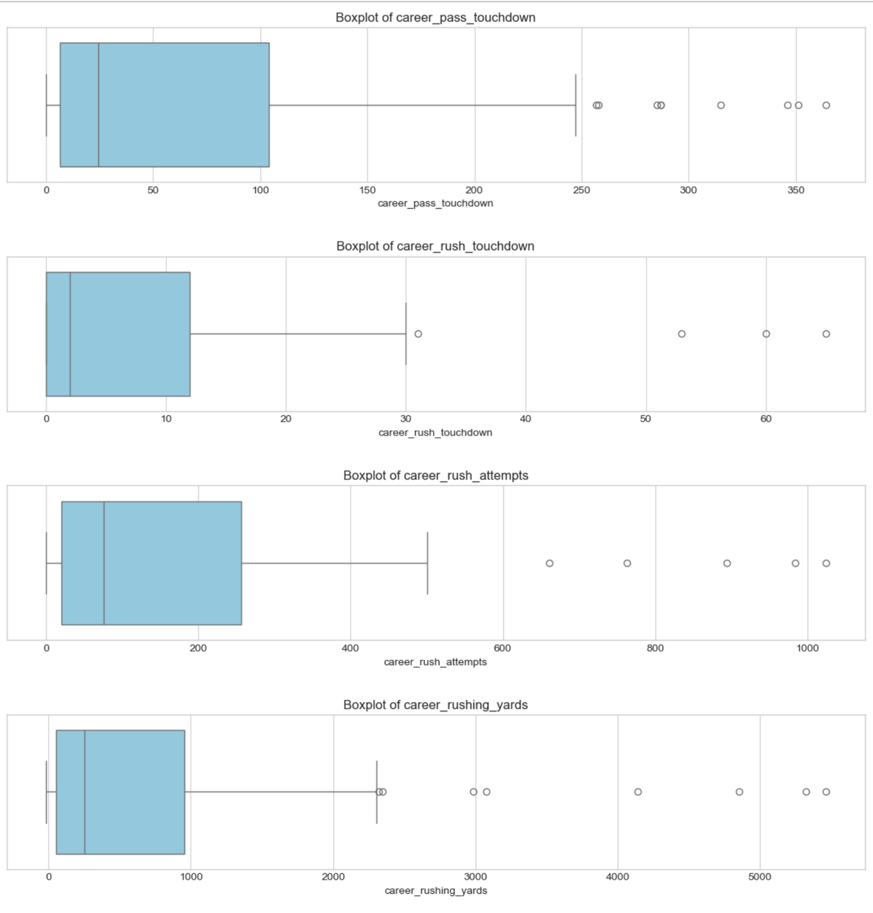
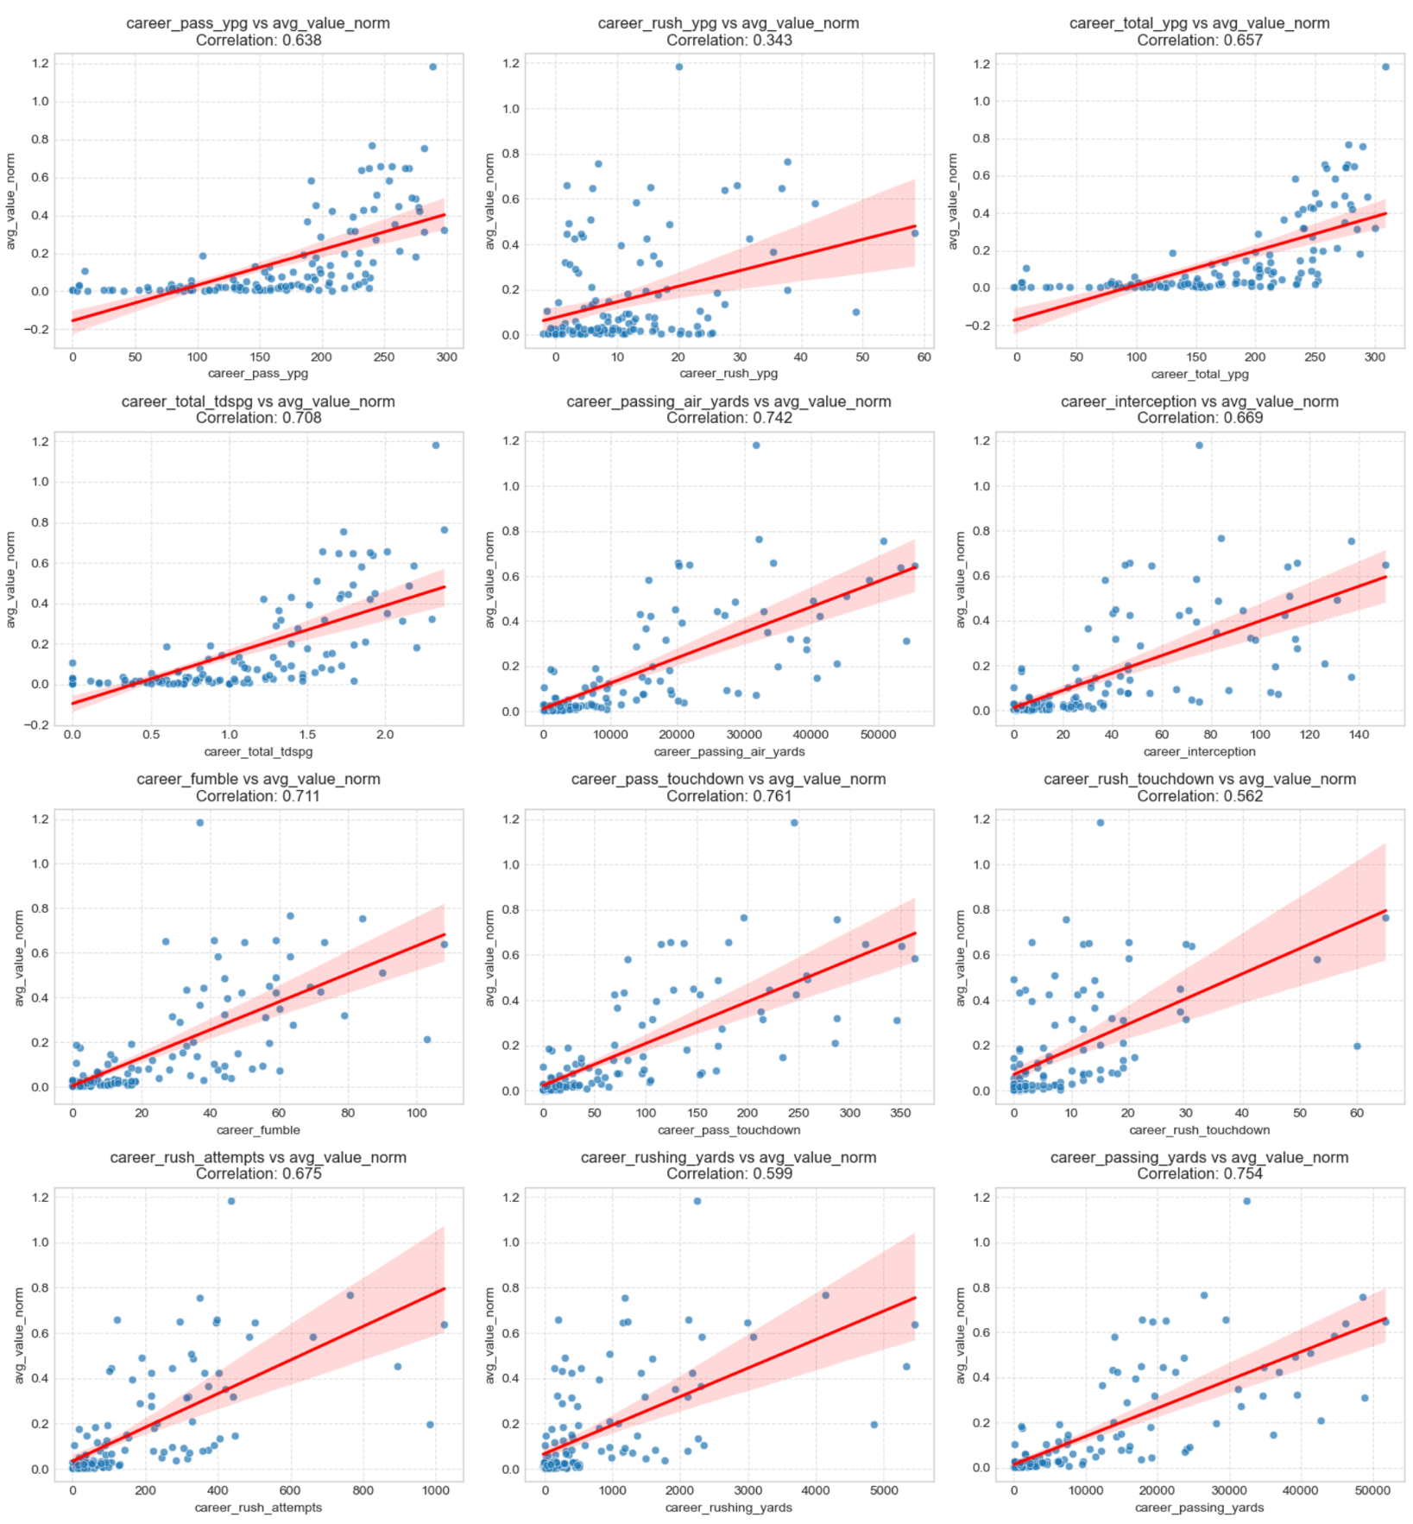
Summary of Data Analysis pt. 2
Univariate visualizations, such as histograms and boxplots, were created to visualize the distributions of the continuous variables; these visualizations identified outliers as most of these variables were right skewed in their distributions
Correlation analysis was used to identify and measure the relationship between the X and Y variables. This verifies for linearity. Positive relationship exists between the X and Y variables. This is illustrated with a scatterplot and heatmap.
The heatmap illustrates that multiple X variables are correlated with each other, which is addressed in Ridge regression. Important to do so that this does not affect the final analysis

Slide 6
Summary of Data Analysis pt. 3
Multiple models are used to compare accuracy in predicting contract values based on the predictor variables: linear regression, Ridge, and Random Forest
These models are used to predict avg_value_norm, the Y value, along with determining the R-squared score. Bar plots are used to visualize the importance of the optimal features for these models
Ridge is used to address the multicollinearity of the predictor variables
Random Forest uses multiple decision trees to enhance prediction accuracy
StandardScaler() is used to standardize the values of the numeric features, which improves the performance of the algorithms sensitive to the scale of data. Crucial so that no single feature disproportionately influences the model due to differences in scale
Mean squared error (MSE) and root mean squared error (RMSE) are used to calculate the mean of the squared differences between actual and predicted values. These actual and predicted QB values are visualized in a scatter plot

Slide 7
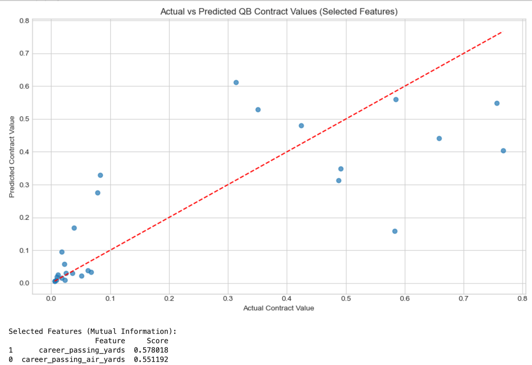
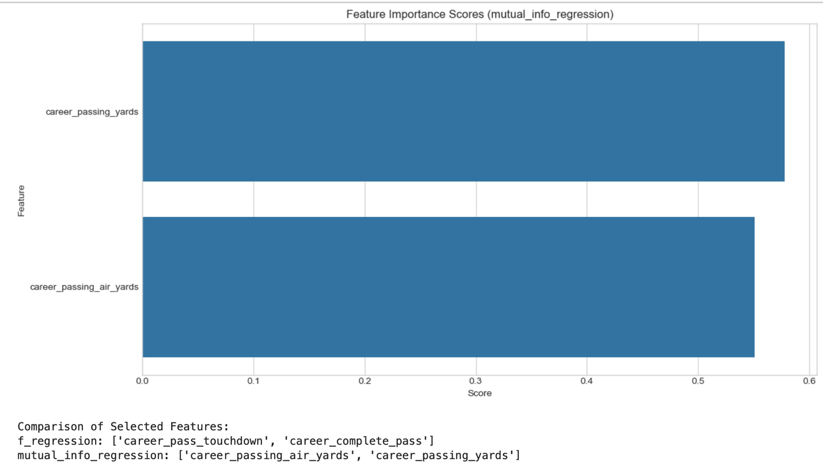
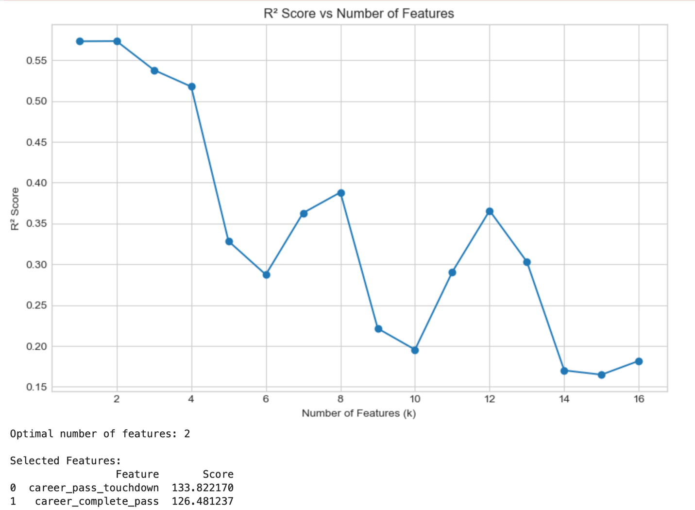
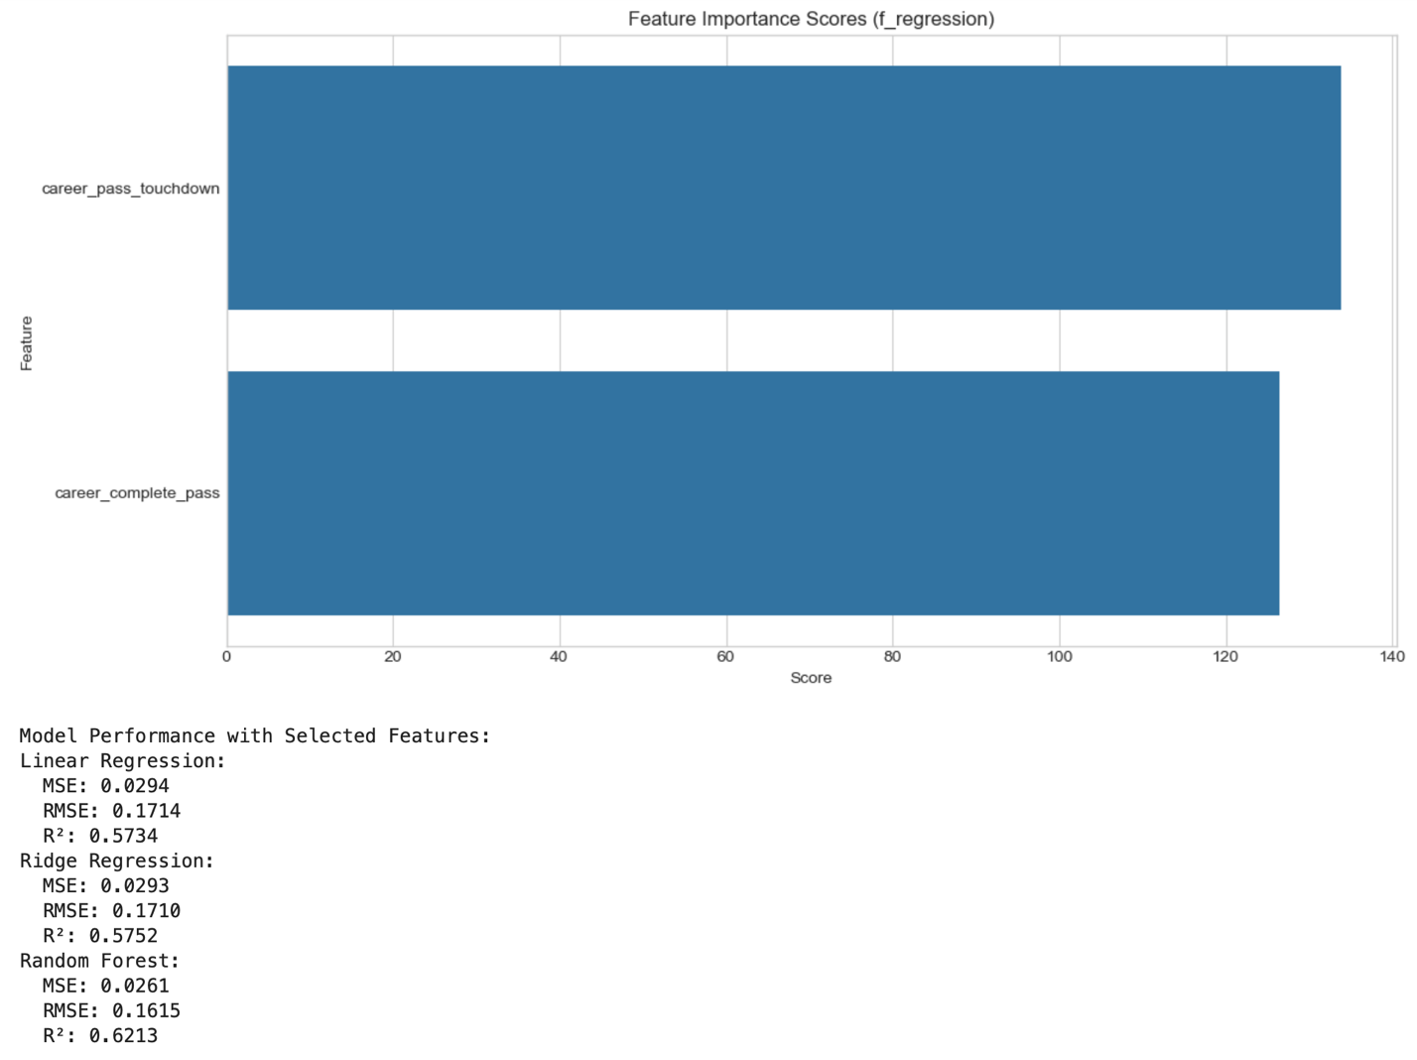
Outline of Findings
The line graph illustrates that the optimal number of features in the linear regression is 2, as this is when the R-squared value reaches its highest value of 0.55
This illustrates the results of the best regression model when SelectKBest with f_regression and mutual_info_regression is applied: the most important features based on their scores are career passing touchdowns (133.82), career pass completions (126.48), career passing air yards (0.57), and career passing yards (0.55)
The most accurate model is Random Forest, as its R-squared is 0.62, which means it describes 62% of the variance of the results for contract value
There are a few quarterbacks who are paid above average based on their performances, this is illustrated in a dotted line graph

Slide 8
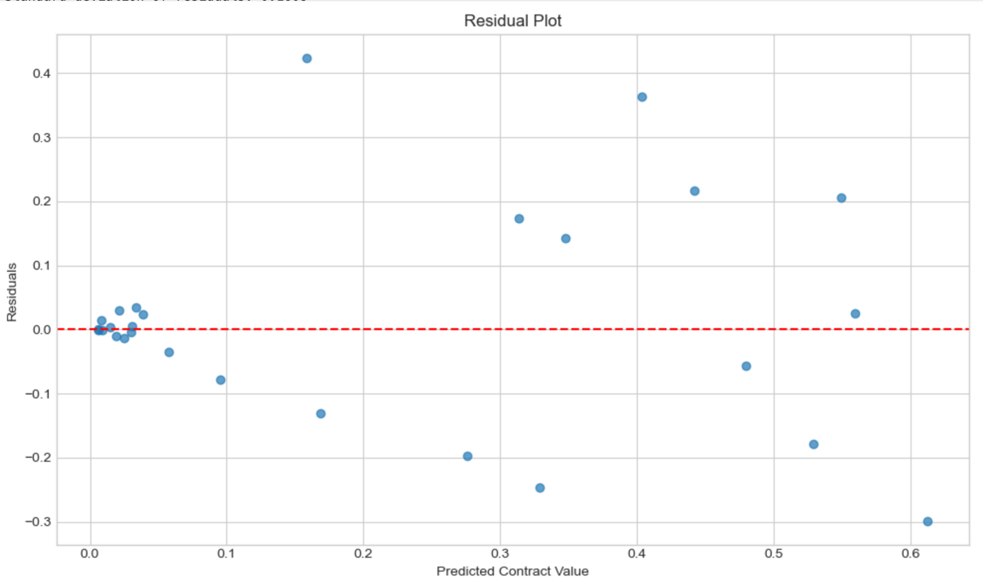
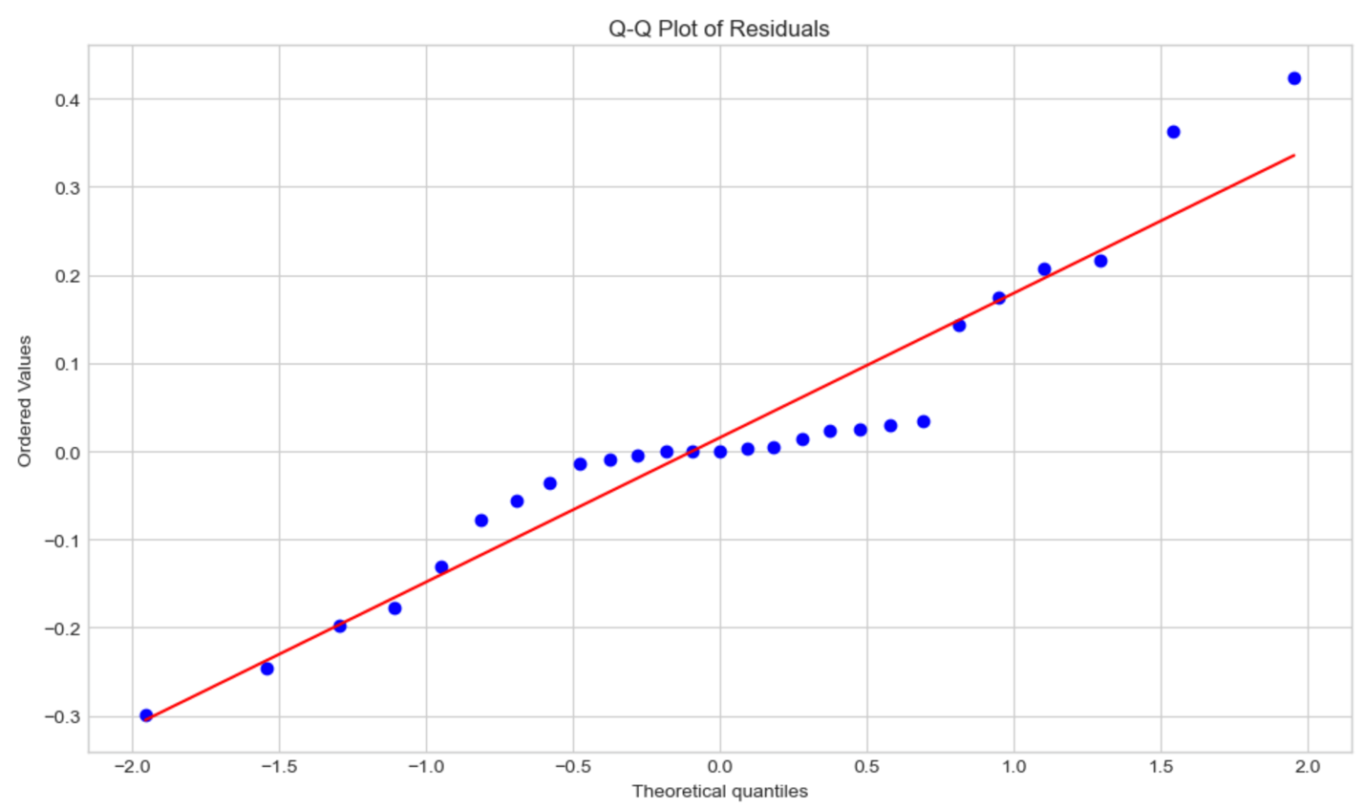
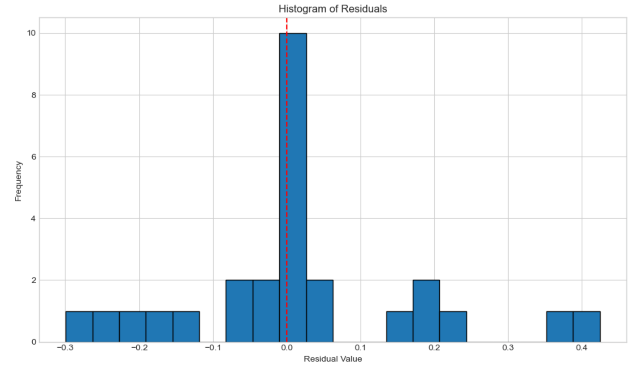
Outline of Findings pt 2
Residual analysis is executed for the Random Forest model
The residual mean is 0.01, and the residual median is 0; these values demonstrate that the model is unbiased
These results are illustrated with residual plot, histogram, Q-Q plot, and residuals vs actual values plot
Some variance exists based on the plots and histogram, which means that some outliers remain

Slide 9
Limitations
Histograms can appear misleading when data ranges are adjusted, especially with variables that span large scales.
Boxplots may misrepresent spread when distributions are skewed.
Pandas and NumPy can struggle with large or complex datasets due to memory demands and limited support for non-numeric structures.
Train-test splits can produce variable performance results depending on how the data is divided.
Linear regression is sensitive to outliers, whereas ridge regression reduces variance at the expense of introducing additional bias.
Random forests cannot extrapolate beyond the range of the training data.
Feature-selection methods, such as SelectKBest, F_regression, and mutual_info_regression, each have drawbacks: they may overlook feature interactions, be heavily influenced by outliers, or yield results that are more difficult to interpret.
Notes:
SD = measures the dispersion of data, how far values are from mean
- These variables are from the original model, some variables were omitted due to size of sample size and inaccuracies; narrow down model for greater focus on certain variables

Slide 10
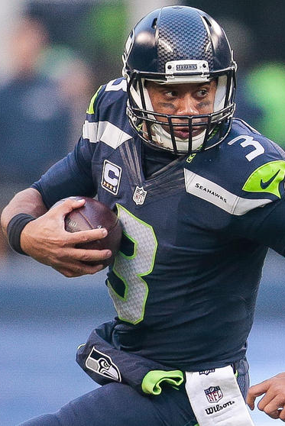
Summary of Proposed Actions
The analysis addresses the research question: “Does an NFL quarterback’s performance influence their compensation?”
The most important benefit of this analysis is that it identifies the most important performance metrics that influence a quarterback’s contract value.
NFL teams are given a salary cap that they must adhere to when signing players. These teams must deliberate on numerous metrics to determine whether they should continue paying their players. This is important because these teams are trying to win Super Bowls while spending as little as possible to save money for other positions on the roster if needed. If a player is overpaid, then it takes away the team’s ability to spend money on other positions where they may be weak.
The findings of this study have the potential to enhance team management, expedite decision-making, and ultimately lead to more informed decisions regarding which quarterbacks to sign.
Based on the analysis of 132 unique quarterbacks over the course of 12 seasons, the most important features that influence contract value are career passing touchdowns, career complete passes, career passing air yards, and career passing yards with scores of 133.82, 126.48, 0.57, and 0.55.
Given the skewness of these variables, it appears that a few high performers are valued significantly more for their performance than the average quarterback.
This demonstrates that a quarterback is valued more for their passing ability than their rushing ability.
It also illustrates that the most important feature is passing touchdowns, which makes sense since teams need to score points to win games.

Slide 11
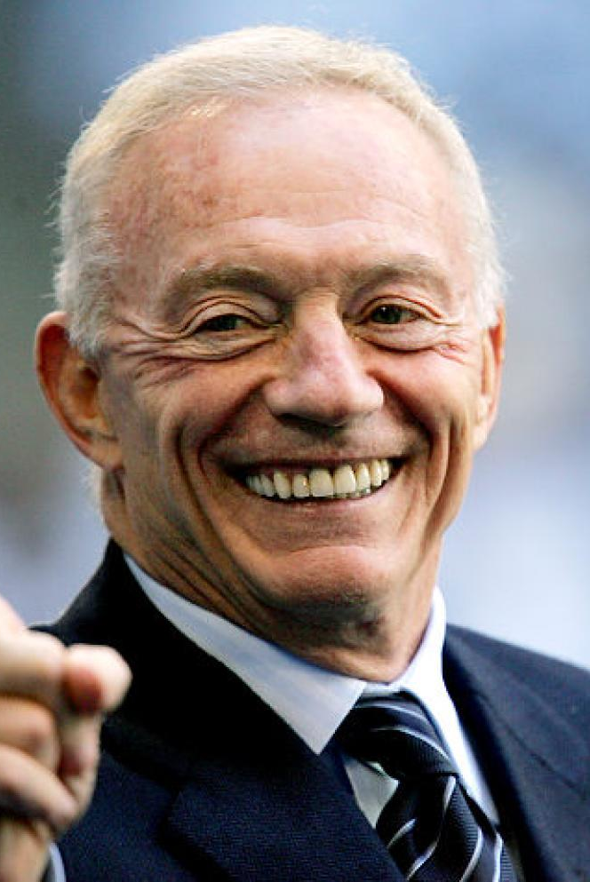
Conclusion: Implications & Future Research
Some suggestions for future research include, but are not limited to, the following:
Implementing cross-validation with GridSearchCV or RandomizedSearchCV to optimize model parameters rather than using fixed values
Using Lasso Regression for feature selection
Using filter methods such as forward and backward feature selection, as well as recursive feature selection
Examining the strength of an offensive line and its influence on quarterback compensation
Evaluating salaries for wide receivers and running backs to determine whether these positions improve a quarterback’s ability to be paid more
Longitudinal studies could be conducted to follow quarterbacks seasonally to see if performance changes with time and how that may affect compensation
Combining certain predictors and averaging them or calculating efficiency ratios to assess the value of a specific metric, such as the TD-to-INT ratio

Slide 12
References
Badenhausen, K. (2020, September 11). The NFL’s Highest-Paid Players 2020: Bosa Tops with $44 Million, Mahomes Sits Out. Retrieved November 10, 2025, from https://research.ebsco.com/c/25xrgu/viewer/html/aildt534az.
Hyde, P. (2025, August). NFL Stats 2012-2024: NFL Stats for Projections [Data set]. Kaggle. https://www.kaggle.com/datasets/philiphyde1/nfl-stats-1999-2022/data?select=yearly_player_stats_offense.csv
Ko, K. (2024, December). Quarterback Win Rating: A Superior Methodology for Evaluating and Compensating Quarterbacks. AAYAM: AKGIM Journal of Management, Vol. 14 Issue 3, p1-7. 7p.
Liu-Sontag, N. (2023, August 27). NFL Contract and Draft Data: Contains NFL contracts and draft pick data for players between 2000 and 2023 [Data set]. Kaggle. https://www.kaggle.com/datasets/nicholasliusontag/nfl-contract-and-draft-data
Matplotlib (2025, February 27). Using Matplotlib. User Guide. Retrieved November 5, 2025, from https://matplotlib.org/stable/users/index.html
Ngugi, J. (2022, May 21). Handling Missing Values – Data Science. Medium. Retrieved November 25, 2025, from https://ngugijoan.medium.com/handling-missing-values-data-science-7b8e302264ee
NumPy (2024, December 14). NumPy User Guide. Retrieved November 5, 2025, from https://numpy.org/doc/stable/user/
Pandas (2024, September 19). Pandas User Guide. User Guide. Retrieved November 5, 2025, from https://pandas.pydata.org/docs/user_guide/index.html
Scikit-Learn (2025, November). User Guide. Retrieved November 21, 2025, from https://scikit-learn.org/stable/user_guide.html
SciPy (2025, February 17). User Guide. Retrieved November 13, 2025, from https://docs.scipy.org/doc/scipy/tutorial
Seaborn (2024, January 1). Seaborn User Guide and Tutorial. Retrieved November 5, 2025, from https://seaborn.pydata.org/tutorial.html

